Slide 1
Bill Assistance &
Income Eligible Programs
Pay less for your energy
PSE 2024

Slide 2
PSE does not share personal customer information with any entity.

Slide 3
Assistance Programs
Bill Discount Rate
PSE Help

Slide 4
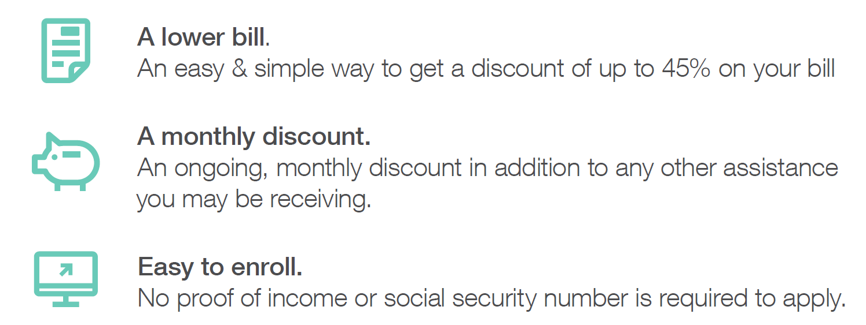
Bill Discount Rate (BDR)
Visit: PSE.com/Discount

Slide 5
PSE HELP
(Home Energy Lifeline Program)
Receive $100 to $1,000 credit towards your PSE past due or current account balance
This program is funded by PSE customers and not funded by government funds
The PSE HELP program applications are currently reviewed through your local county agencies
You do not need to contact your local county agency, nor will they contact you unless your are one of the 5% audited for Bill Discount Rate/PSE Help
PSE Help
Notes:
Application processing is taking about 1 to 2 months

Slide 6
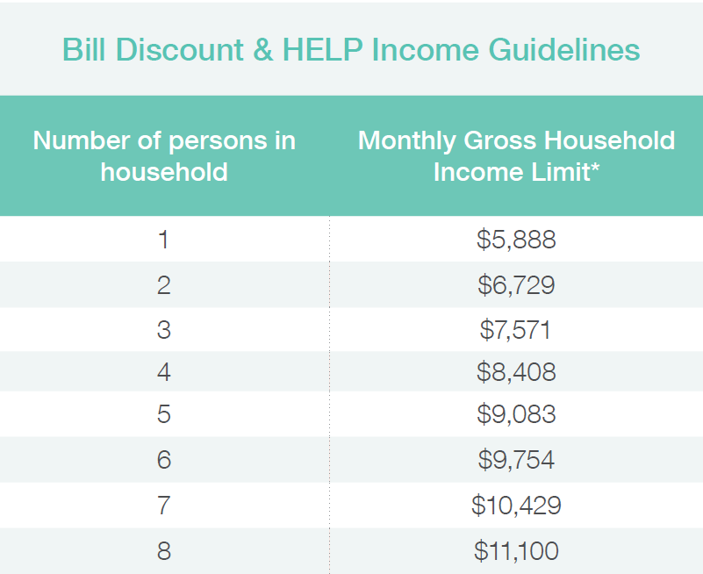
King County Eligibility BDR

Slide 7
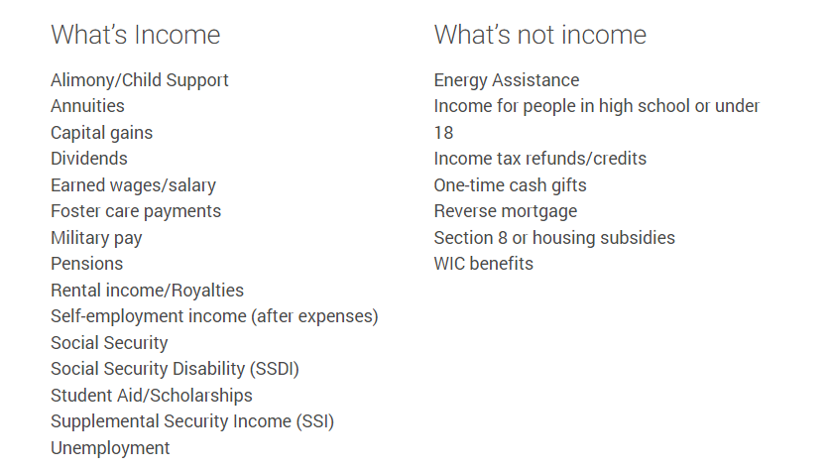
Types of Income
PSE Help
Notes:
Forms of income that need to be listed on the application, not all may be listed here.

Slide 8
Application Process
How to complete the Bill Assistance request step by step
Visit PSE.com/discount to start
Visit PSE.com/discount

Slide 9
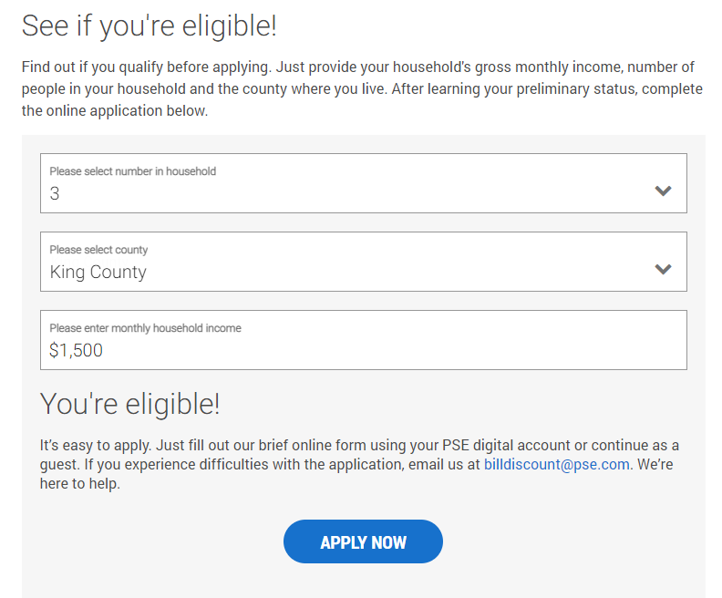
Find out if you qualify before applying
Notes:
Its helpful and encouraged that the applicant have their electric/gas bill handy when applying for the Bill Discount Rate program. This will help with the process.
This program is only for PSE customers, customers who have an account with PSE for gas or electric.

Slide 10
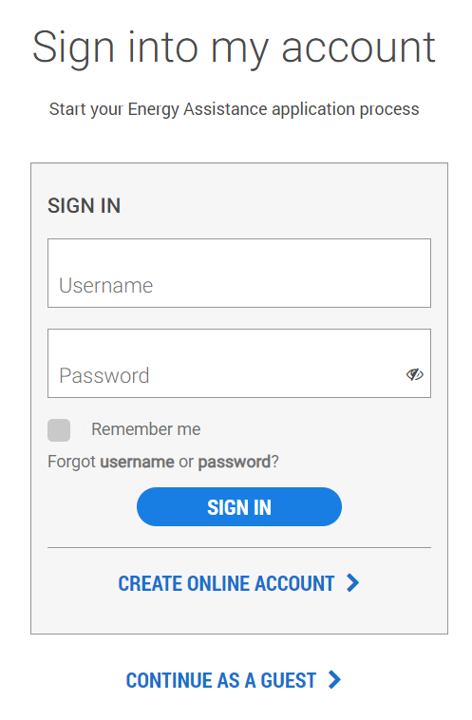
Option 1:
Sign into your PSE account
Notes:
The application process will be different for everyone.
There are 3 ways for the customers to apply.
Signing into their online PSE account
If they do not have a online PSE account, they can create one
Or they can simply just continue as a Guest
Depending on what they choose the process will be different

Slide 11
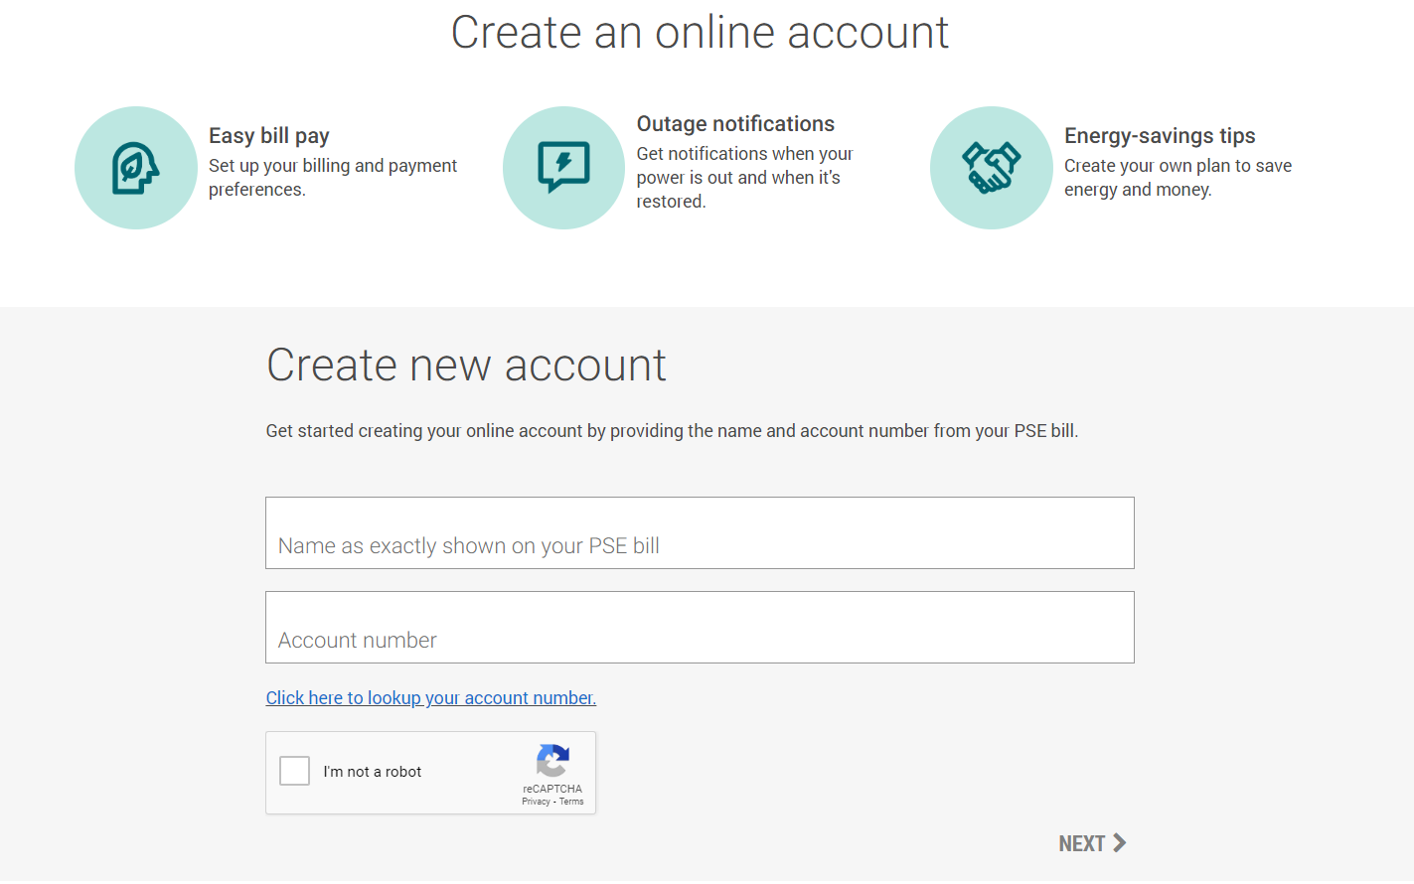
Option 2:
Create a PSE.com account
Notes:
If they select ‘Create Online Account’ this is the screen they will see
Name on the account and account number is required, and they will want to check the box ‘I’m not a robot’ and click NEXT

Slide 12
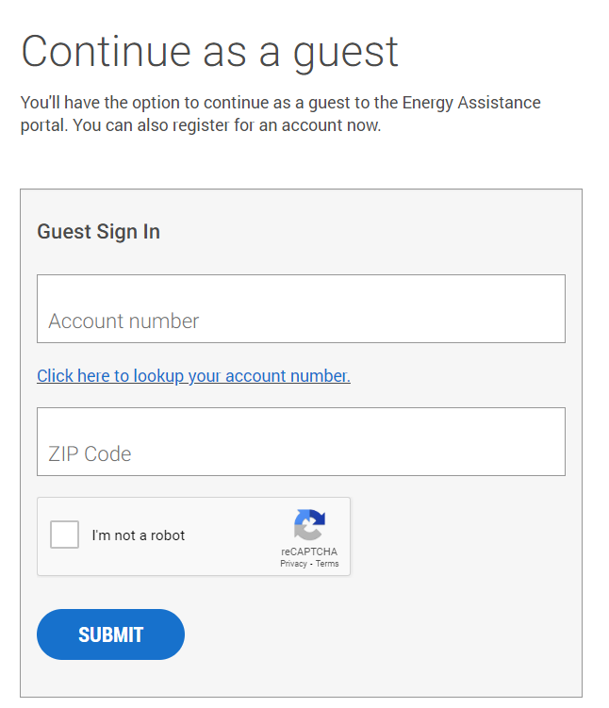
Option 3:
Continue as a Guest
Notes:
If they select ‘Continue As A Guest ’ this is the screen they will see. Here they have two options to provide account number or look up account.
Account number and Zip code is required, and they will want to check the box ‘I’m not a robot’ and click SUBMIT
If they do not have their account number with them, then you’ll need to click on: ‘Click here to lookup your account number’ to look up account by account holders name and phone number, then the next screen on the slilde will show up

Slide 13
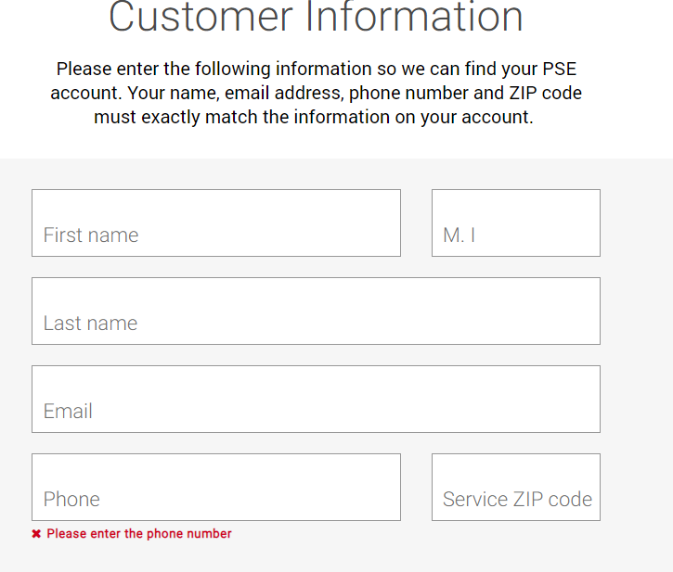
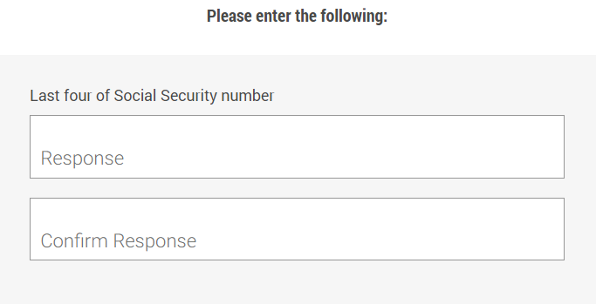
Continuing as a Guest
Notes:
Note: Name and phone number has to be exact as PSE has it registered or the account will not be located

Slide 14
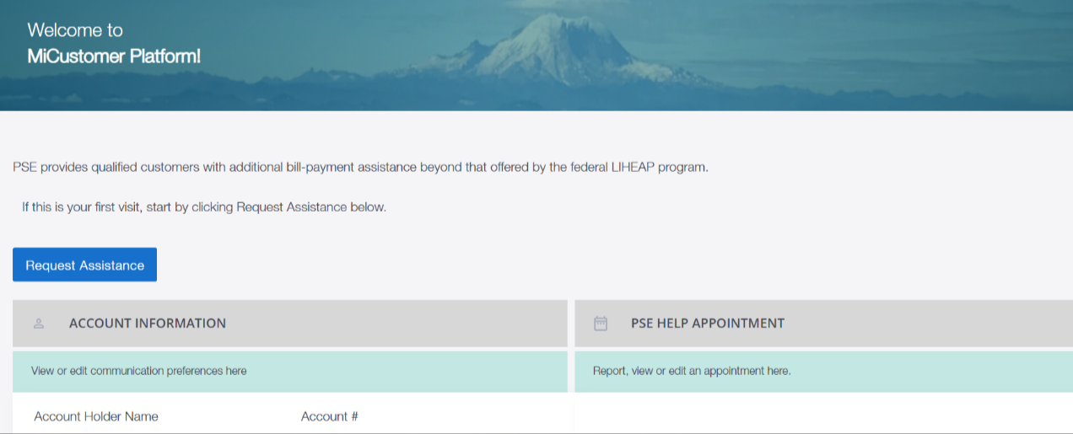
Notes:
If the customer see’s this screen, they need to click on the ‘Request Assistance’ button

Slide 15
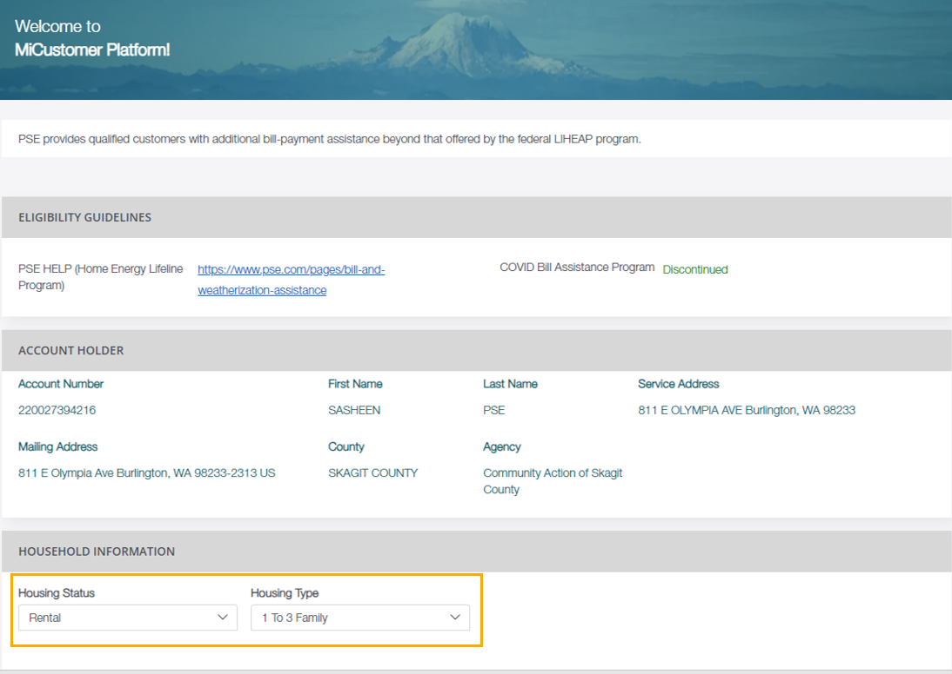
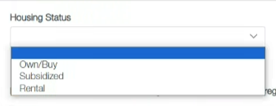
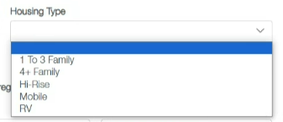
1 to 3 family = Single Family House
4+ Family = Apartment, Condo, Duplex, Townhome
Visit PSE.com/discount
Notes:
On this screen, they will want to scroll down to Household Information and start adding type of housing and add all members in the household (including children)
What is meant by housing status? Select the option that best describes the home from three options: do you own it, is it subsidized housing, or do you rent.
What is meant by housing type? Select the option that best describes the structure of the home from five options:
A 1-3 family home is a single family dwelling, a duplex, a triplex, or other consisting of three or fewer connected units.
A 4+ family home is a fourplex or greater.
A Hi-Rise is an apartment building.
A mobile is a mobile home.
An RV is a recreational vehicle.

Slide 16
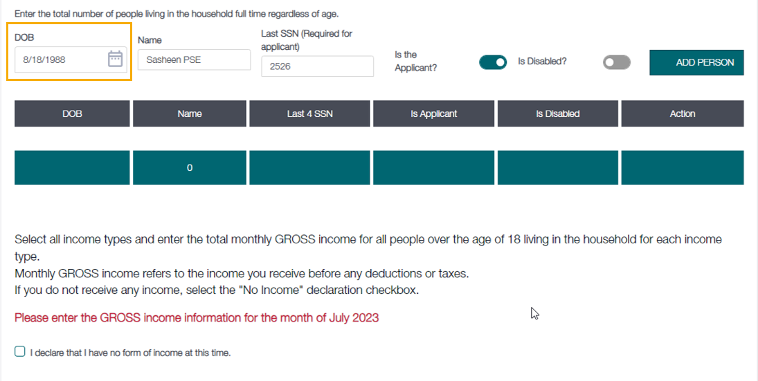
Don’t forget to click on add person for each
All household members should be listed here
Notes:
All household members must be listed (all adults and children).
You will need to list the account holder as the first household member. This is the PSE account holder.
SSN is not a requirement even though it is asked for. If the customer does not have one or they do not feel comfortable providing one, simply add 0000.

Slide 17
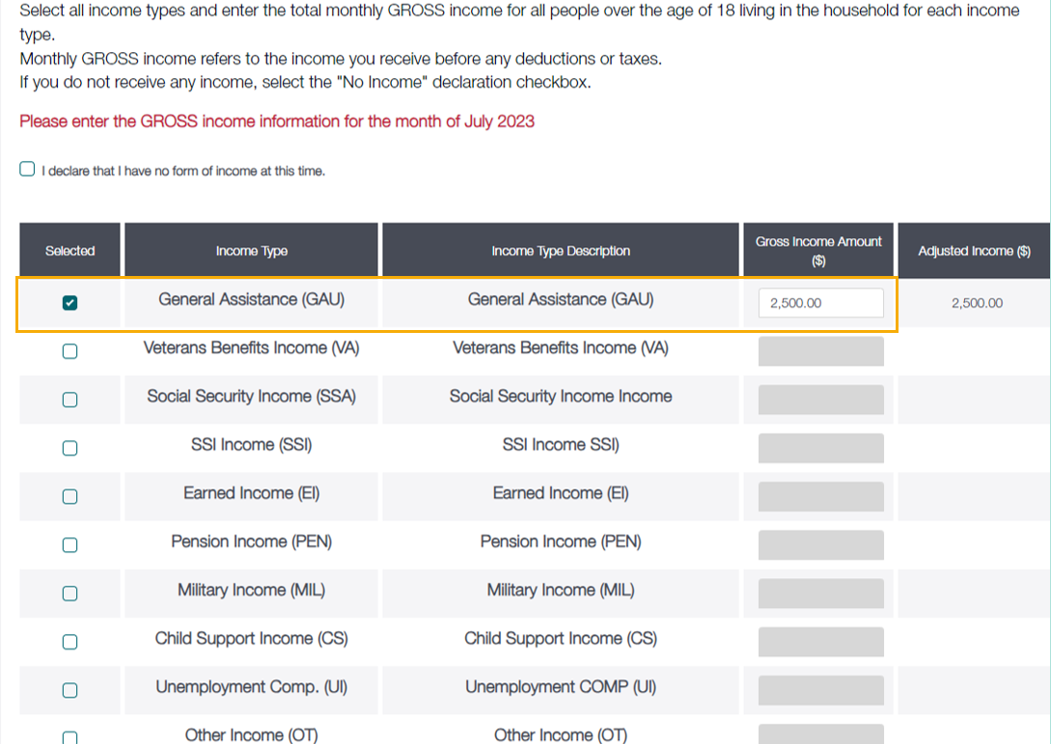
This box should only be checked if nobody in the household is working
Visit PSE.com/discount
Notes:
What counts as household income? This means the combined income of all household members age 18 or older. If there is zero income in the household, check the ‘I declare that I have no form of income at this time’ box.
Cash payments do not count, so do not include.

Slide 18
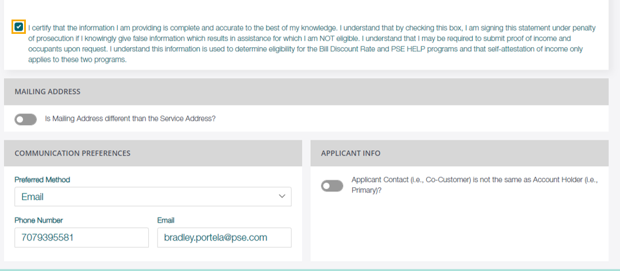
This box must be checked in order to submit your application
Notes:
Check the ‘I certify’ box to move forward and update the preferred method of contact.

Slide 19
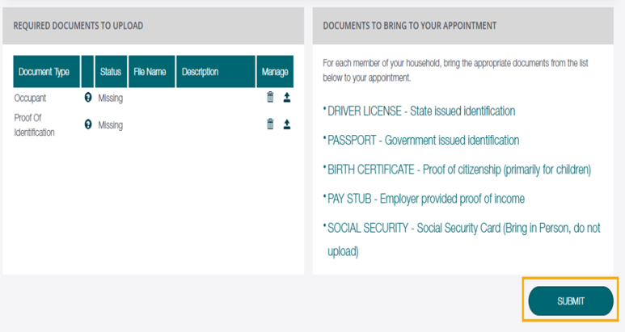
Documents do not need to be uploaded. The only time you will upload documents, is if you are one of the 5% audited and proof of income is requested from your local agency.

Slide 20
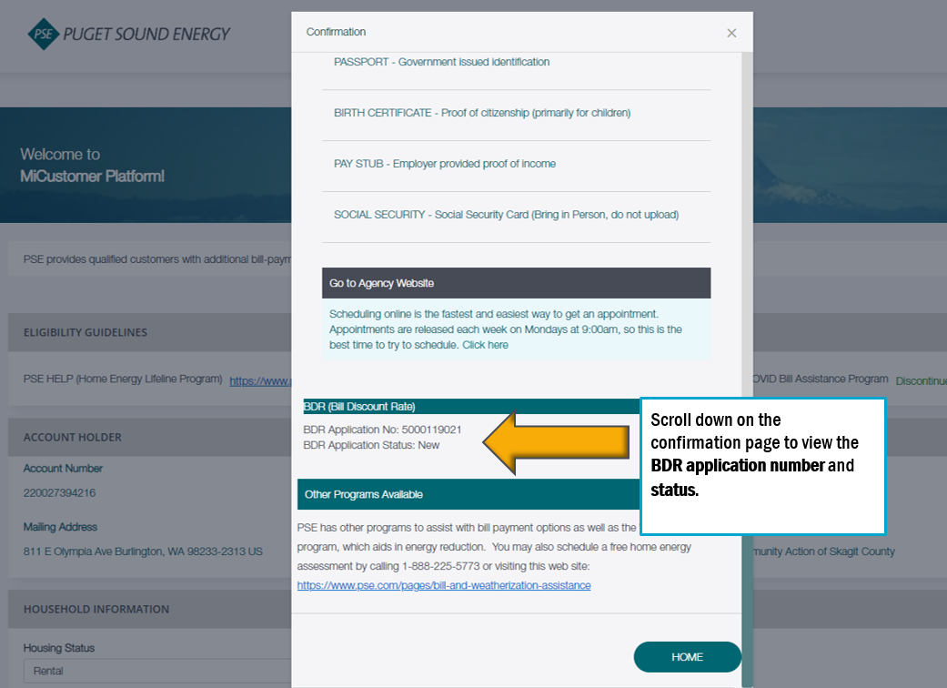
After submitting your application, it will mention that you need to contact your local agency for next steps. You do not need to contact your local agency.
Notes:
There is no need to contact PSE customer service or your local agency for status update unless they contact you.

Slide 21
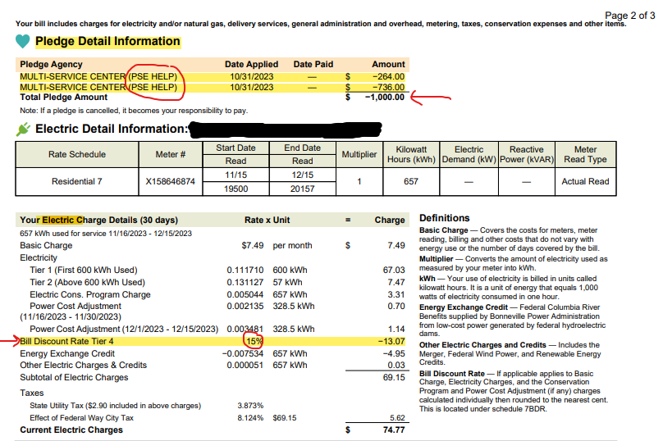
Example of PSE Bill
Notes:
Bill Discount Rate takes one month to reflect on customers bill and PSE Help take up to two months for funds to show as credit on the customers bill.
Customer does need to reapply each year for Bill Discount Rate and PSE Help (same time each year)

Slide 22
Other assistance programs
you may qualify for

Slide 23
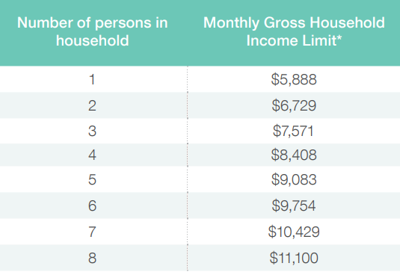
Income Requirements
23

Slide 24
24
Community Solar

Slide 25
25
IE Community Solar
Notes:
Once enrolled into Community Solar, there is no need to re-enroll every year.

Slide 26
How Do I Subscribe?
Right now, income-eligible customers can contact an Energy Advisor at 1-800-562-1482 to enroll or we can add you to the waitlist here, today.
You will be asked to affirm you meet the household income requirements during the enrollment process to self qualify. Proof of income is not required.
PSE.com/solarforall
26
IE Community Solar

Slide 27
Home Weatherization Assistance
The Home Weatherization Assistance program is a partnership between PSE, federal and state funding sources.
It’s a way for us to connect our income-qualified customers to the local agencies that can assess your home and provide free, whole-home upgrades to help lower your monthly energy bill.
27
Visit: pse.com/home
Notes:
This program is for fixing problems in your home to reduce energy waste, improve health and safety, and increase comfort – at no cost to income-eligible customers.
Funded by the government, therefore requires SSN/ITIN and a lot more documentation.
Appointment wait times are around 4 to 6 months.
Seattle Office of Housing (Seattle residents) seattle.gov/housing
206-684-0244
Weatherization
King County Housing Authority
206-214-1240
Weatherization

Slide 28
28 | Visit: Pse.com/home

Slide 29
What is the Process Like?
The Home Weatherization Assistance program is not administered through PSE. It is administered through county agencies.
Wait times for the Home Weatherization Assistance program can be long.
They will conduct a home assessment to determine how best to weatherize your home and possibly upgrade equipment that is old or inefficient. The list of free upgrades you could potentially receive is extensive.
Pse.com/home

Slide 30
Documents
Your agency may ask you to bring
You will need to bring the following items with you to your appointment:
Social security card or legal document with name and social security number for everyone in your household
Picture ID with birthdate for the applicant
Verification of total household income for the three months prior to the month of appointment for everyone in your house
Adults age 18 and older with no income in any one of the three required months must sign additional forms to confirm no income
Current month’s energy bill
Disconnection notice with current address (if applicable)
Rent/lease agreement or proof of residence
Depending on circumstances, more information may be required.
LIHEAP

Slide 31
Salvation Army Warm Home Fund
Provides short-term, emergency bill payment assistance to PSE customers facing financial difficulties.
For customers who have received a disconnect notice or who’s service has been disconnected.
The funding are contributions from other PSE customers.
Salvation Army Warm Home Fund
Notes:
Income guidelines are identical to Bill Discount Rate and PSE Help
North King County
Bellevue, 425-452-7300
Central King County
Seattle (downtown), 206-447-9944 Seattle (White Center), 206-767-3150 Seattle (Greenwood), 206-783-1225
South King County
Des Moines, 253 946-7933 Enumclaw, 360-886-1011 Federal Way, 253 946-7933 Kent, Algona, Auburn, Black Diamond, 253-852-4983 Pacific 253-852-8655 Renton, 425-255-5969

Slide 32
Federal program assisting with keeping electricity and gas services and avoid disconnection.
LIHEAP is administered through local county agencies. You will need to contact them for an appointment.
Program that requires documentation of your personal information.
LIHEAP
LIHEAP
Notes:
Household/Family Size Contact your local agency in King County: Multi-Service or Hopelink Federally Funded: Requires SSN and a lot more documentation and income limits are lower than all the other programs
150% of FPL
1
$1,699
2
$2,289
3
$2,879
4
$3,469
5
$4,059
6
$4,649
7
$5,239
8
$5,829
9
$6,419
10
$7,009

Slide 33
Questions?
Rosa Gonzalez
Outreach Manager
Rosa.Gonzalez@pse.com

