Slide 1
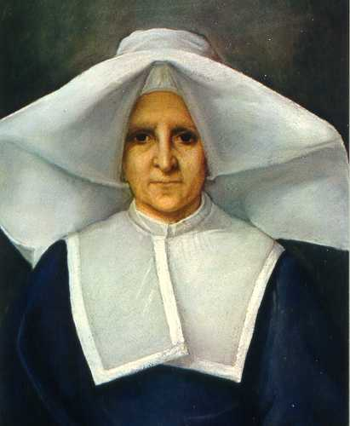
The Rendu Orientation
An introduction to the Spirituality of the Home Visit
A Formation Program for New Vincentians and others who wish to renew their calling to this ministry.
Developed for our Centennial year of Mission
Seattle – 2020
Presented by:
Mirya Muñoz-Roach
Ned Delmore
Last updated 2/20/21
Notes:
Ned and Mirya Introduce themselves - and ask paricipants: Name and Parish
Who wants to start us with a brief introduction of who is Rosalie Rendu?
Why “The Rendu Orientation” ? - because THE 1st vincentians were formed by her a Daughter of Charity of SVdP ( their beginings)
This is not volunteerism – it is a ministry – a vocation – a call – “who calls” (Isaish 22)

Slide 2
Agenda
Part 1 – Spirituality of the Home Visit
Part 2 – Practical Tools and Resources
Part 3 – Conference Meetings

Slide 3
Opening Reflection from the words of Dorothy Day

Slide 4
Love in the Abstract
It is not love in the abstract that counts. We have loved the workers, the poor, the oppressed, but we have not loved “personally.” It is hard to love.
It is the hardest thing in the world, naturally speaking. Have you ever read Tolstoy’s Resurrection? He tells of political prisoners in a long prison train, enduring chains and persecution for the love of their brothers, ignoring those same brothers on the long trek to Siberia.
It is never the brothers right next to us, but the brothers in the abstract that are easy to love.
Dorothy Day

Slide 5
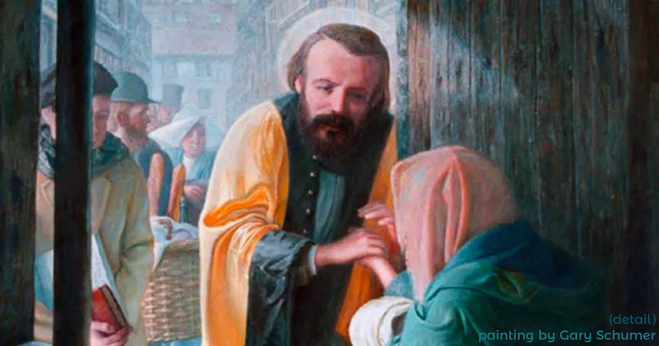

Slide 6
Attitude of the Home Visit begins in our Heart
Spirituality of the Visit
Be kind and love, for love is your first gift to the poor. They will appreciate your kindness and your love more than all else you bring them.
Rosalie Rendu
19th century

Slide 8
SLOW-DOWN and SMELL the ROSES
In our speed-driven and frenzied world, we are often distracted.
Our minds are often racing as we look ahead to our next obligation.
We have become prisoners to our urgent deadlines, to do lists and the internet.

Slide 9
Notes:
Listen to your heartbeat - Pay attention to your breathing
YOU JAM / THEIR JAM – awareness grows with practice
Listen to your own thoughts prior to listening to a neighbor

Slide 10
What pressures or burdens do our neighbors carry with them?
Break Out Session

Slide 11
What pressures or burdens do our neighbors carry with them?
Lack of Support Systems
Disconnected from Community and Family
Legal Financial Obligations
Medical Conditions
Legal Problems
Poverty/Debt
Trauma
Discrimination
Language Barrier
COVID ?

Slide 12
What attitudes or thoughts prevent us Vincentians from connecting with our neighbors?
Notes:
Listen to your heartbeat - Pay attention to your breathing
YOU JAM / THEIR JAM – awareness grows with practice
Listen to your own thoughts prior to listening to a neighbor

Slide 13
Let’s consider our Biases
Implicit bias: thoughts you didn’t know you have - we all have them.
Different cultures idiosyncrasies
Language barrier

Slide 14
Stay until you Leave… Mathew’s Gospel
The danger of hurrying is we don't take the time to notice and see and hear the truth of our neighbors’ lives. We may see what is in front of us, yet we overlook the periphery, the nuance, the sigh of depression that is symptomatic of something deeper.
WE ARE ON THEIR SCHEDULE!

Slide 15
Practical Tools
In The Home Visit – Listening is Loving
How to JOIN with a person in need
Your influence is in the depth of your relationship.
Joining is relational. It is the foundation of Vincentian spirituality. If we are not in the right mind or heart to join we will not see the Poor.
Judgment obstructs joining.
Lead with your heart; gauge with your mind!
We do NOT need to be counselors or case-managers to listen, observe, attend and be respectful.
Be aware of your Body Posture, Facial Expression, Tone and Voice Inflection (important during phone visits too)

Slide 16
How to begin the conversation:
Practical Tools
We know you are experiencing a difficult time, will you tell me more about it?
Who do you go to when you feel trapped or stressed financially or emotionally?
What kind of support system do you have?
In the end we may ask ourselves:
What is the deeper need here?
What more do we feel is called for?

Slide 17
The forest is mostly dark, it's ways to be made a new, day after day, the dark richer than the light and more blessed provided we stay brave enough to keep on going in. Wendell Berry

Slide 18
Break! Tools and Resources for the Home Visit right after a 5 minute break!
Notes:
5 minutes

Slide 19
Cycle of the Home Visit
Vincentian CALLS neighbor schedules visit
VISIT is scheduled – preparations begin
VISIT occurs
Reflective Listening, Pledges, Resources
Post Visit Reflection, Pledge made & Database updated
Reflective Listening at the Conference
Calls to helpline
and
Check database

Slide 20
Two Vincentians Conduct Home Visit
HAND-OUT
Always visit in pairs.
Pair new with experienced.
Two-gender teams have an advantage.
Safety first.
Notes:
Hannah
Go over the Home Visit Teams overview on the slide. Source: Serving in Hope Module VI, Session 6.4, page 44.

Slide 21
Two Vincentians Conduct Home Visit
HAND-OUT
General Flow of the Home Visit
Vincentians will take time to listen and be compassionate towards their neighbor.
Needs will be assessed (food, utility, rent, etc.)
Vincentians will give neighbor a resource list and pledge assistance from conference if possible/appropriate.
If you have to consult someone else before making a pledge do so expeditiously. Always be responsive, trust of neighbors is precious for them and it re-generates hope in humanity.
Notes:
Ned & Hannah
Remember that you are there to assess their needs. Do not be judgmental of their environment. Spend time with them and listen to their story and their problems. Come prepared to take notes on the visit. Each home visit will probably be a little different, but there are generally 3 things that will happen on the visit:
Vincentians will take time to listen and be compassionate towards their neighbor.
Needs will be assessed (food, utility, rent, etc.)
Give them a resource list.
Go over the list with them, starring or highlighting agencies that will be most likely to give them the assistance they need. Coach the client to tell the other agencies that they are working with SVdP, that we have made a home visit and assisted them in such and such a way.
Source: Holy Family and Our Lady of Guadalupe SVdP Guidebook, page 14.

Slide 22
Confidentiality
HAND-OUT
Why is confidentiality during and after the Home Visit important?
Limit information sharing as much as possible – need-to-know basis
Exceptions: cases of suspected abuse or neglect; self-harm
Other best practices:
asking neighbor’s permission
Release of Information (ROI)
restricting info in email
protecting identity in promotional material
Notes:
Hannah
Refer to HANDOUT; be brief.
Ask participants why confidentiality is important? Try to elicit each of the points below:
Maintaining confidentiality is one way we serve our neighbors with dignity and respect at this vulnerable moment in their lives.
Builds trust, establishes rapport, shows compassion
You are encouraged to remind the neighbor early in the home visit or interaction that everything he or she tells you will be held in confidence.
Who is it appropriate to share information with?
All information offered by a neighbor can be shared with your home visit partner, other members in your conference, and with your conference support person (should a question or issue arise from the interaction).
You cannot share neighbors’ personal information with anyone else. This includes spouses and pastors!
Other best practices:
Sharing information with a landlord or utility provider – Ask for verbal permission before discussing a neighbor’s information with landlords, utility providers or other potential payees.
Sharing information via email – avoid including sensitive information in the body of emails, but instead, link to the neighbor’s file in the database. Use the neighbor’s initials, especially with DV survivors, for example. Always avoid faxing neighbor information.
Utilize Release of Information forms when sharing information with other service providers – It is common and appropriate to refer a neighbor to other agencies. Have the neighbor sign a “Release of Information” before sharing information with that agency. A sample R.O.I. is in your packet (Home Visit Orientation).
Always ask for the neighbor’s permission to share their information.
Ask participants what they think might be exceptions to confidentiality. Feel free to add to, but be sure to elicit, the points below:
If a neighbor states or in some way makes you suspect that they want or intend to do harm to themselves or another person.
If you suspect abuse or neglect of any resident or family member you visit.
We ask that you refer to your Resource Guide on Abuse and Neglect provided by the Seattle/King Council should any such suspicions arise. Please contact your Conference Support person as well regarding any questions related to an abuse and neglect suspicion.
You can utilize neighbor information in promotional material such as bulletin stories or pulpit pitches. It is encouraged that you will share about the power of the Home Visit in your community, and beyond. However, all names and personal identification information must be changed!
If you have any questions regarding confidentiality, please contact your conference president or conference support person.

Slide 23
What makes a good Case Management Referral?
HAND-OUT
Two (or more) total hardship issues present
Neighbor is veteran, elderly, disabled, or DV
Neighbor is potentially self-sustaining
Neighbor has been served by the Conference frequently
Consult with Conference President to determine together if it is an appropriate referral.
Notes:
NED
How to make a Case Management Referral
After using the Home Visit Assessment tool, if you think the neighbor is a good fit for a Case Management Referral, here are the next steps:
Step 1: Consult with Conference President to determine together if it is an appropriate referral.
Step 2: Case Management Consent/Referral form needs to be read (to or by) and signed by the neighbor. This may become evident during the initial Home Visit, but more likely it will take more than one Home Visit to get a full sense of the neighbor’s situation.
Step 3: Conference President emails the assigned case manager.
Conferences are encouraged to remain engaged as is appropriate – ownership.
Created in collaboration with Macquiva Bermudez-Vega, Senior Manager, Program Support Services.

Slide 24
Vincentians record information in database
HAND-OUT
Notes:
Hannah
BRIEF mention of this. Information on each home visit must be recorded in the Online Conference Records System. Let Vincentians know that they will need to request of their Conference President and fellow Vincentians a training on this.
Next VFG is on March 21 at Seattle U and will have a Conference Database Workshop and Q&A

Slide 25
Join the Monthly Vincentian Peer Support Zoom Meeting
Peer Support
Q & A
Resources
Training

Slide 26
Part 3 Conference Meetings

Slide 27
Spirituality in the Encounter with each other in the Conference Meeting
LogJam
Reflective Listening
All Have Equal Voice, Inclusivity
Decision Making
Advocacy

Slide 28
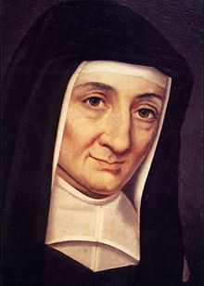
Making decisions the Vincentian Way!
Be sure that you are not depriving your poor of anything. Always look to their needs so that you can give them the best you have, because it belongs to them.
St. Louise de Marillac

Slide 29
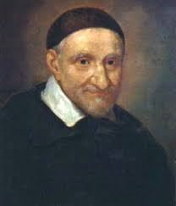
ADVOCACY is in our DNA!
Deal with the most urgent needs. Organize charity so that it is more efficient…teach reading and writing, educate with the aim of giving each the means of self-support. Intervene with authorities to obtain reforms in structure… there is no charity without justice.
St. Vincent de Paul

Slide 30
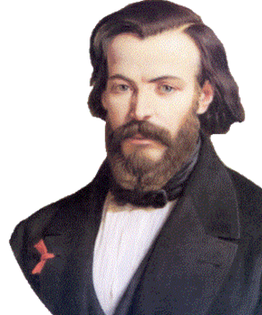
OUR VINCENTIAN CALL
The question which is agitating the world today is a social one. It is a struggle between those who have nothing and those who have too much. It is a violent clash of opulence and poverty which is shaking the ground under our feet. Our duty as Christians is to throw ourselves between these two camps in order to accomplish by love what justice alone cannot do.
Bl. Frederic Ozanam

Slide 31
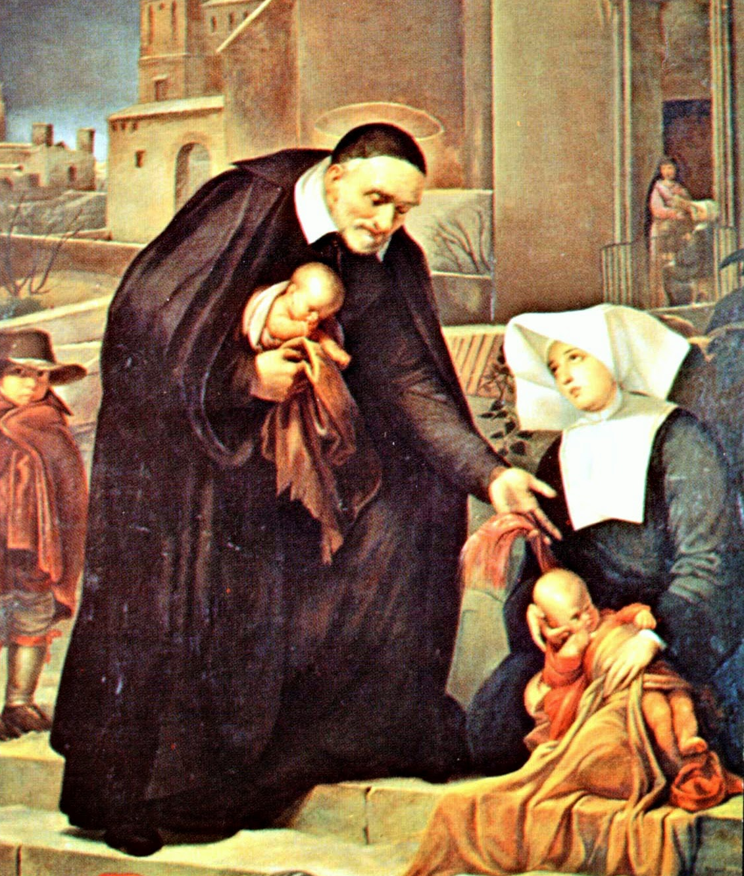
It is our vocation to set people’s hearts ablaze, to do what the Son of God did, who came to light a fire on earth in order to set it ablaze with His love.
St. Vincent de Paul & St. Louise de Marillac

Slide 32
Responding to THE Call… Saying YES to becoming a Vincentian! It’s a Ministry A vocation - A Call A Call to Love as Christ did To Builds a Church that is poor, for the poor… In the words of Pope Francis a “field hospital”
Notes:
This is not volunteerism – it is a ministry – a vocation – a call – “who calls” (Isaish 22)

Slide 33
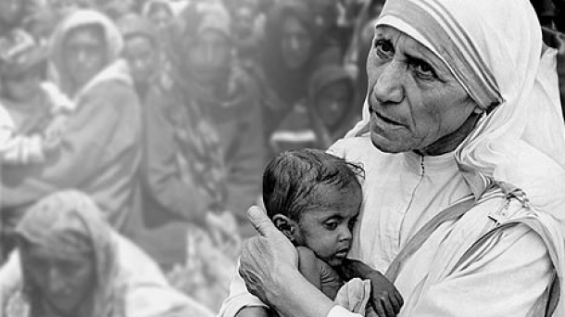
Never have I prayed so well
as in the streets
Blessed Rosalie Rendu

Slide 34
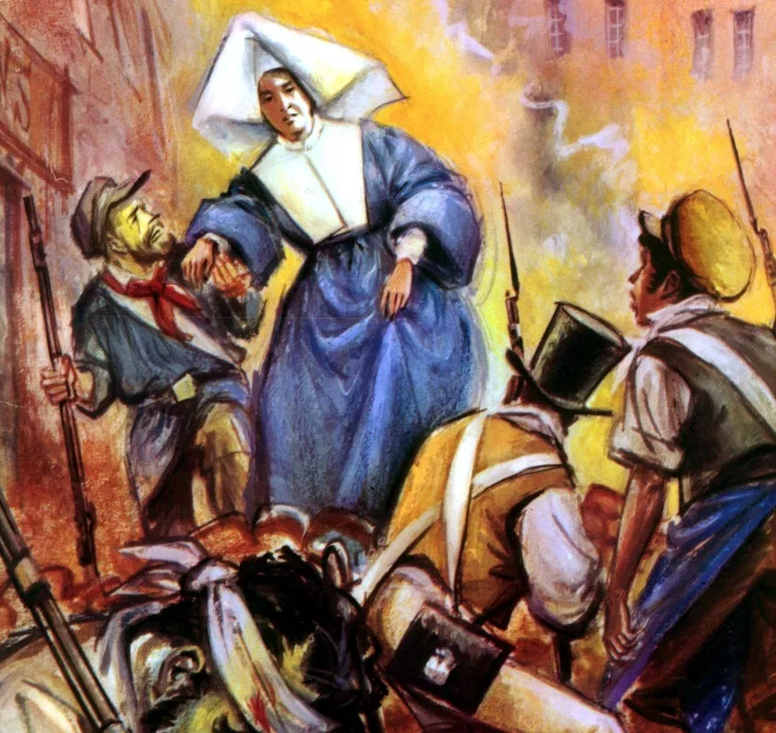
The ZEAL of Blessed Rosalie Rendu
Hunt down poverty!
In order to give humanity its dignity…

Slide 35
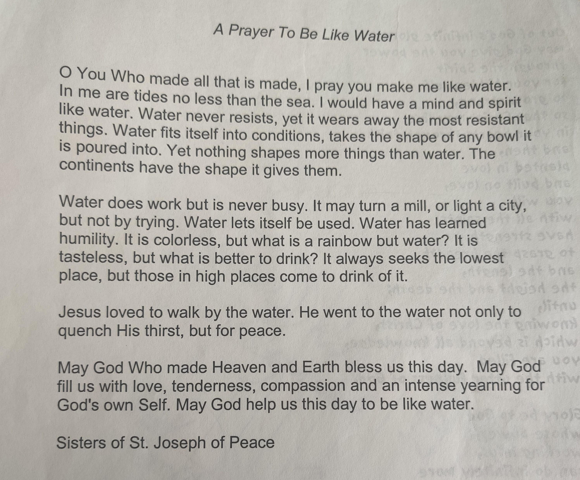

Slide 36
Great Gratitude for your Presence, for Listening, for your Participation and for your Love of our St. Vincent de Paul Mission! Questions?

Slide 37
Additional Resources
HAND-OUT
SVdP Seattle | King County member site: svdpseattlemembers.net
Contact:
Hannah Hunthausen, Mission Renewal and Vincentian Support Manager
hannah@svdpseattle.org; 206-686-5272
Riley Irish, Youth Engagement and Vincentian Support, Rileyi@svdpseattle.org

Slide 38
Other Resources

Slide 39
Empathy vs. Sympathy
HAND-OUT
“Brené Brown on Empathy”: https://www.youtube.com/watch?v=1Evwgu369Jw
Notes:
Play video with no preamble.
Open up for discussion--
For reference:
Video notes/summary:
Empathy fuels connection; sympathy drives disconnection.
Empathy has 4 qualities: Perspective-taking, staying out of judgment, recognizing emotions in people and communicating that
Empathy is a vulnerable choice, because to connect with you, I have to connect with something in myself that knows that feeling
“Rarely, if ever, does an empathic response begin with ‘at least’” – silver-lining
Rarely can a response make something better. What makes something better is connection.

Slide 40
Processing the Home Visit
HAND-OUT
Journal
Where in the visit did you experience unconditional, universal loving?
How do you prepare for the spiritual realities of the home visit?
Where did you find God in your experience in the home visit?
What graces did you receive from God?
Are you able to understand the connection between your poverty, that of the person you are visiting, and spirituality?
Questions for Reflection from Fr. Kevin Moran, ADC Spiritual Advisor.
Notes:
Hannah
Journal. Keeping a Home Visit Journal is a beautiful way to prayerfully process your visits, and to reflect on God’s presence in events and people. The Spirituality of the Home Visit: A Journal is available to anyone who wants one – just contact Hannah.
Key Questions for Reflection from Fr. Kevin Moran, ADC Spiritual Advisor:
Where in the visit did you experience unconditional, universal loving?
How do you prepare for the spiritual realities of the home visit?
Where did you find God in your experience in the home visit?
What graces did you receive from God?
Are you able to understand the connection between your poverty, that of the person you are visiting, and spirituality?

Slide 41
Vincentians pledge support, refer to other agencies and advocate for their neighbors (a compassionate response and best practice is to follow up with a neighbor who was not successful with the referral given) – Vincentians should build relationships and partnerships with other groups who will commit to supporting those we serve through our ministry. Neighbors will benefit from Vincentian support to help navigate complex social service systems and to advocate for them whenever possible.)
HAND-OUT
Food or Foodbanks
Clothing and Household items
Furniture
Rent/Housing
Bus Tickets
Electricity & Utilities
Mental Health
Civil Legal Aid
“No act of charity is foreign to
the St. Vincent de Paul Society.”
- Blessed Frédéric Ozanam
Notes:
Hannah – this section (slides 33 – 44)= 30 minutes
Examples of some support your Conference may be able to provide. Specific forms and types of support are Conference-specific, and training for this should be provided at the Conference level.
HOMEWORK FOR PARTICIPANTS: find out what support and services your Conference does and does not provide. Become familiar with service providers in your Conference area that also provide support and/or offer support the Conference does not provide. Part of the support we can give is knowing other providers to connect neighbors with, especially if the Conference cannot meet all of their needs (which is likely!).

